Slide 1
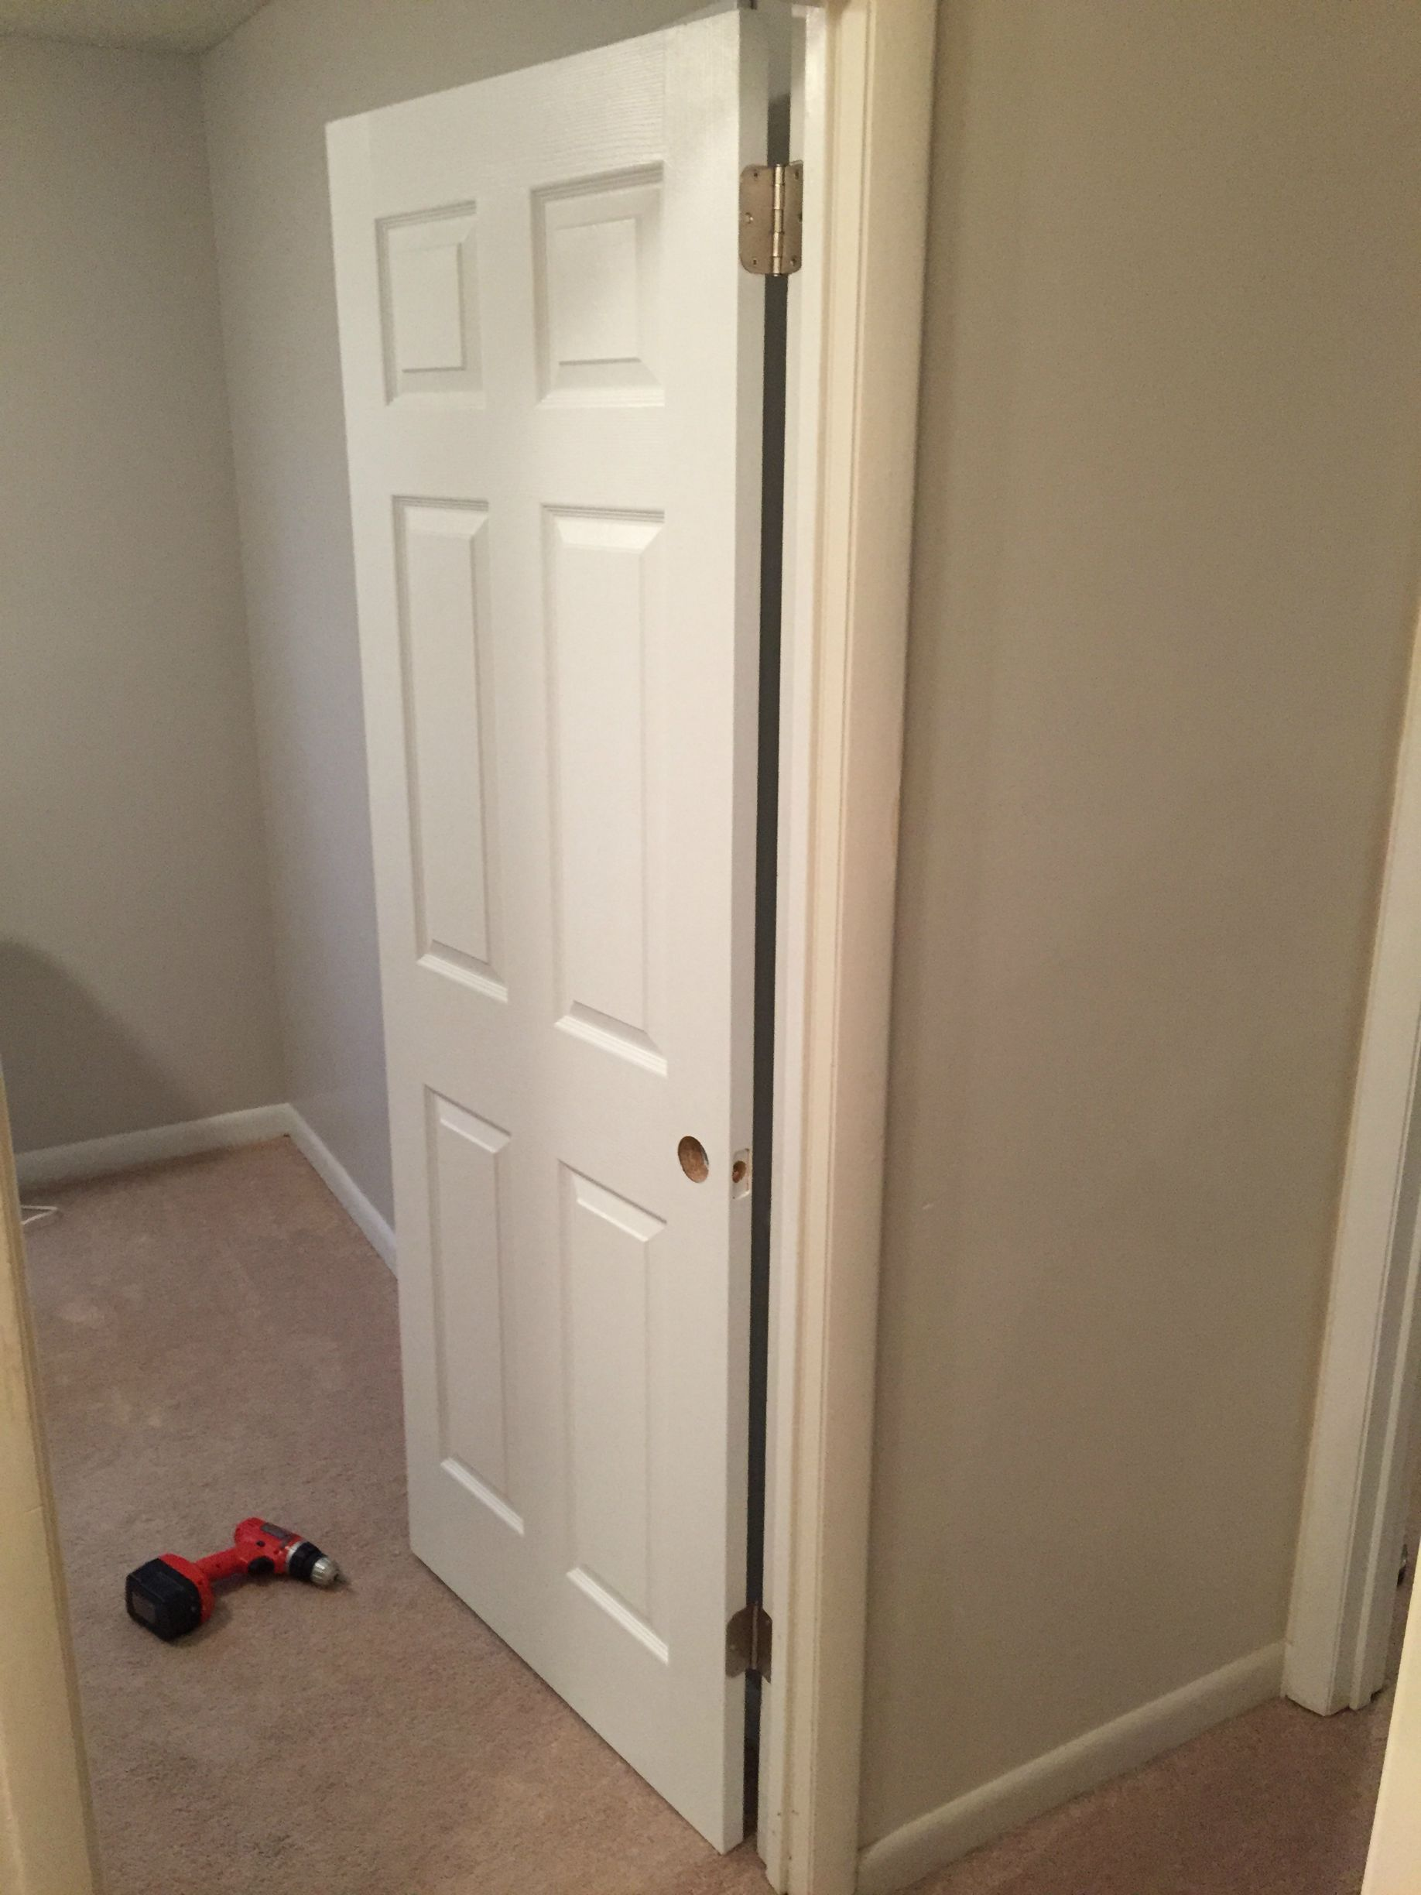

I Was Once
A Very
Crappy
Carpenter
Notes:
SLIDE PURPOSE: This is where everything starts – us defining with our customers how we can make an impact in their business regardless of the technology!
SPIEL: Technology should be transformative, not a to-do list. Because, really, just about any firm can change the way your IT works. Our mission is for IT to change the way your business works. The difference is a game-changer.

Slide 2
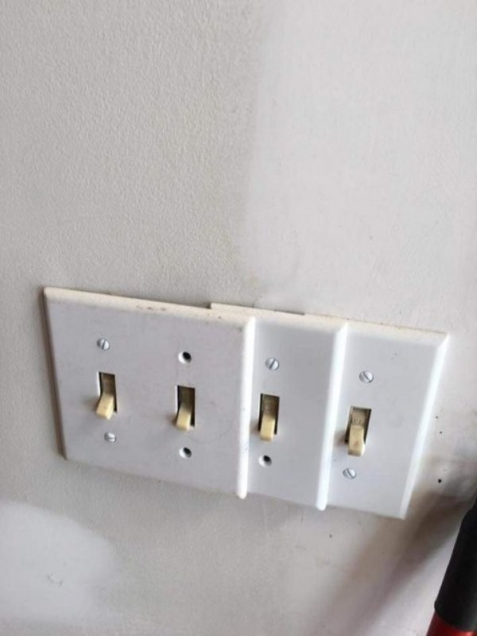
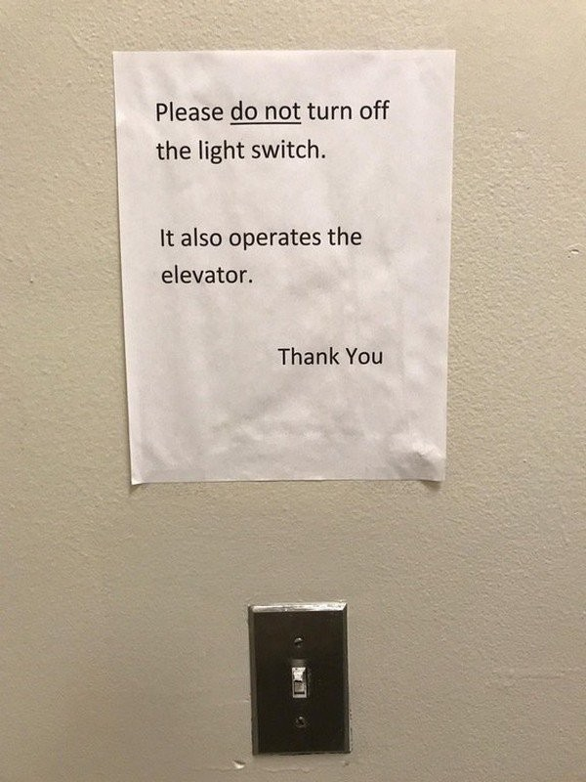
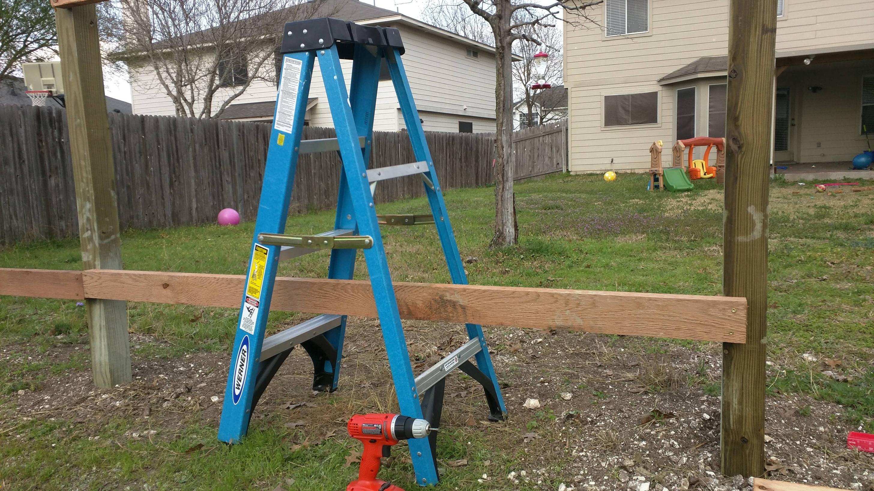
Side projects?
Interest in my work outside?
Certification exams?
User Groups and Conferences (like this)?
Nope.
Minimum effort? Yep.
Notes:
SLIDE PURPOSE: This is where everything starts – us defining with our customers how we can make an impact in their business regardless of the technology!
SPIEL: Technology should be transformative, not a to-do list. Because, really, just about any firm can change the way your IT works. Our mission is for IT to change the way your business works. The difference is a game-changer.

Slide 3
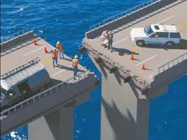
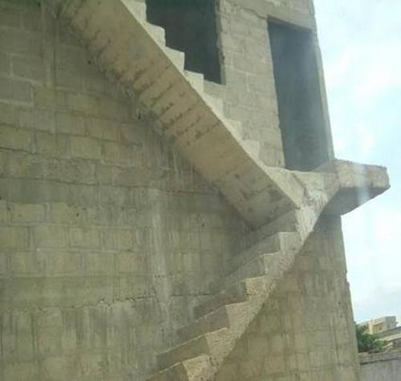
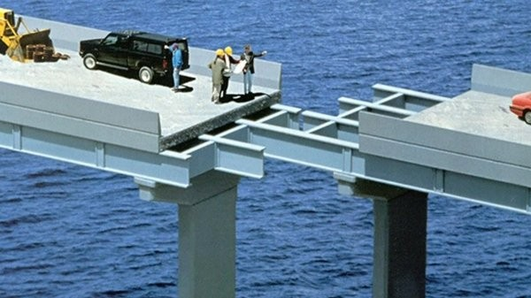
I did what I was told. I didn’t try to expand my skillset.
Video games weren’t going to play themselves, amiright?
I was just doing the job.
And I made goofs all the time
because it was just a job.
Notes:
SLIDE PURPOSE: This is where everything starts – us defining with our customers how we can make an impact in their business regardless of the technology!
SPIEL: Technology should be transformative, not a to-do list. Because, really, just about any firm can change the way your IT works. Our mission is for IT to change the way your business works. The difference is a game-changer.

Slide 4
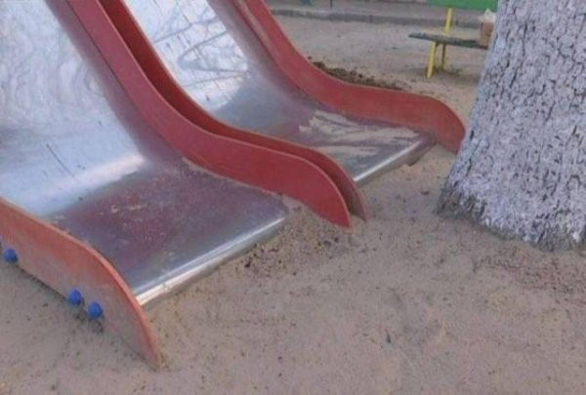
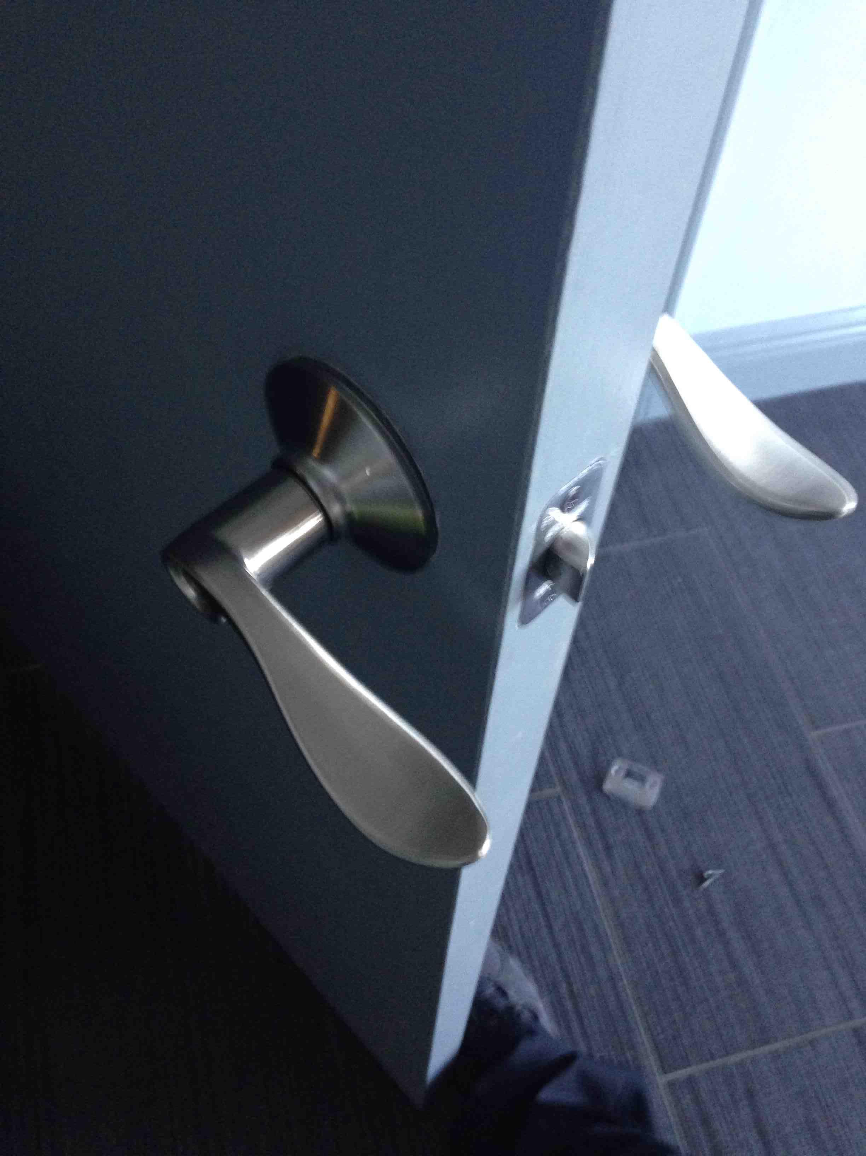
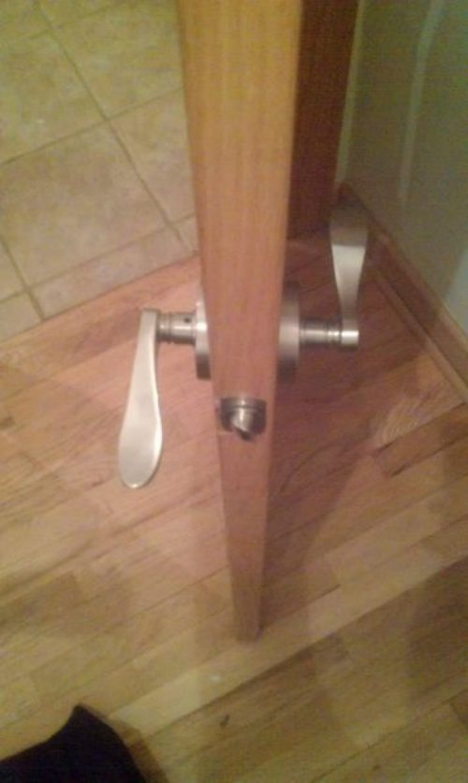
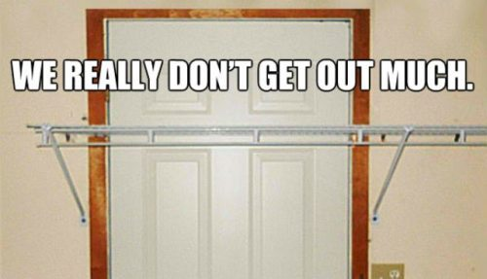
I just wasn’t very good.
I wanted be a better carpenter, I really did…
but couldn’t find time to make myself into one.
That was my employer’s responsibility...
…right?
Notes:
SLIDE PURPOSE: This is where everything starts – us defining with our customers how we can make an impact in their business regardless of the technology!
SPIEL: Technology should be transformative, not a to-do list. Because, really, just about any firm can change the way your IT works. Our mission is for IT to change the way your business works. The difference is a game-changer.

Slide 5
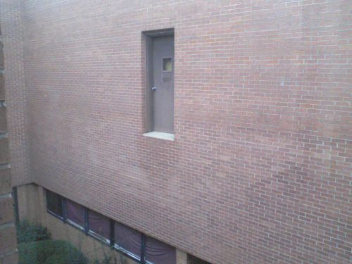
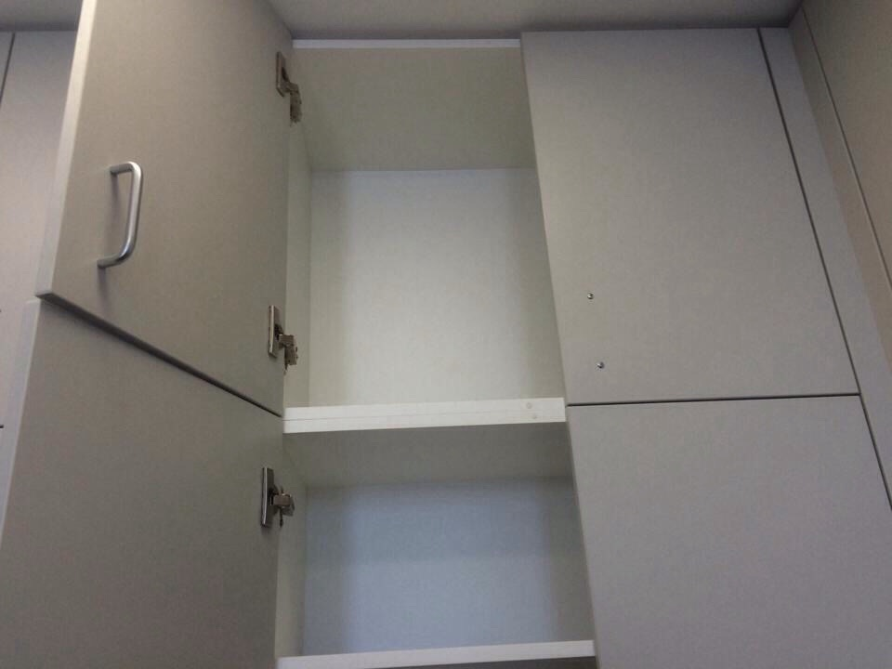
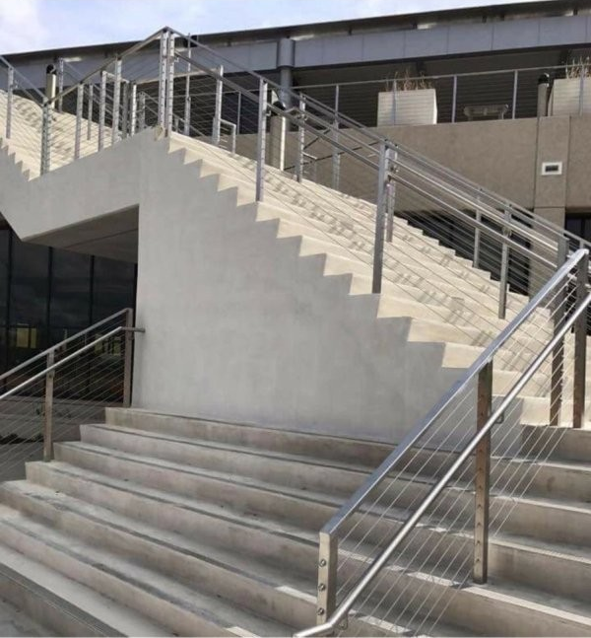
Sometimes what we want to be
and what we do at work every day
aren’t the same thing.
Who’s problem is that?
Notes:
SLIDE PURPOSE: This is where everything starts – us defining with our customers how we can make an impact in their business regardless of the technology!
SPIEL: Technology should be transformative, not a to-do list. Because, really, just about any firm can change the way your IT works. Our mission is for IT to change the way your business works. The difference is a game-changer.

Slide 6
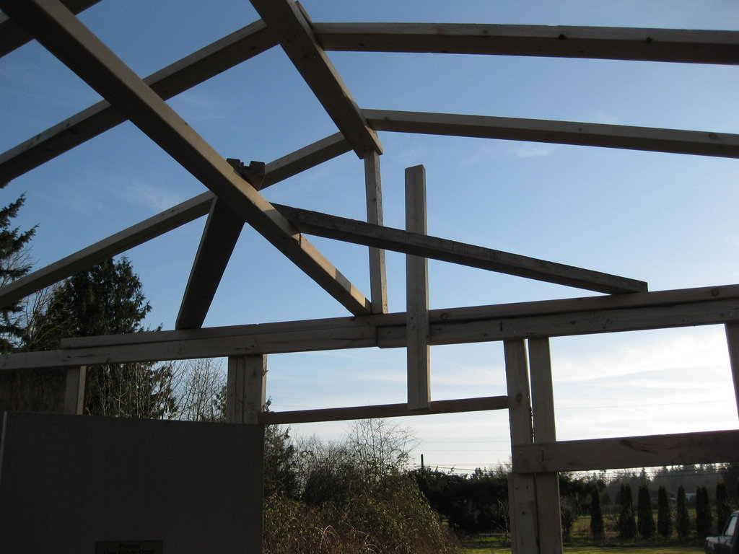
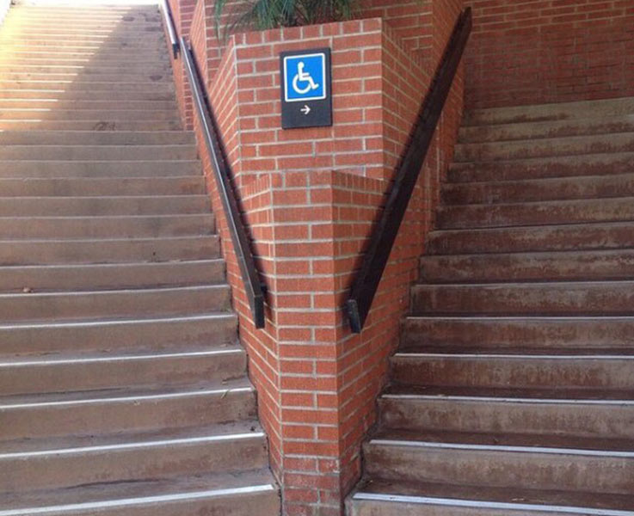
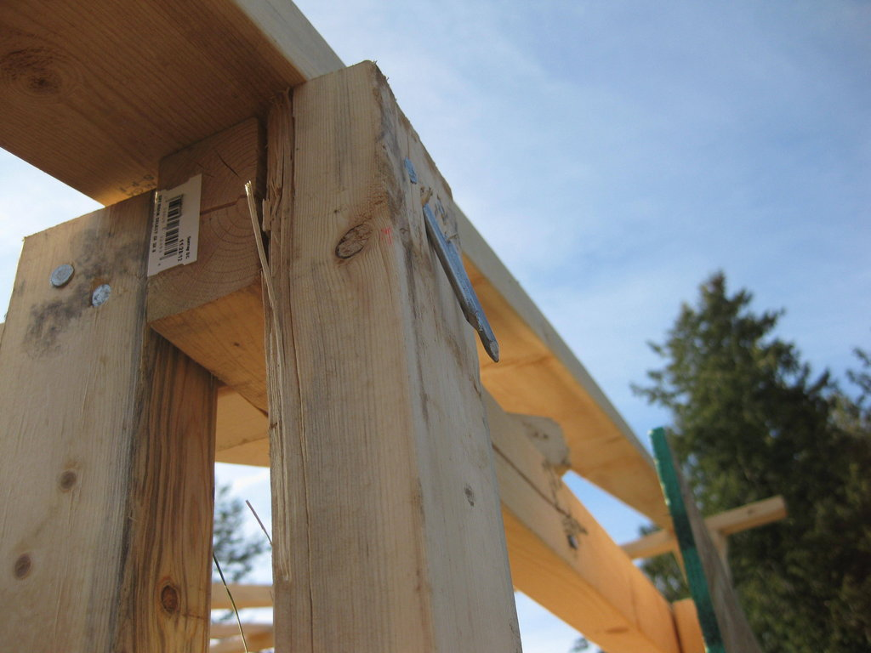
So I started studying on my own time.
I showed interest, paid more attention.
I stopped pointing out roadblocks, and started developing solutions.
I started attending local User Group events.
I created my own related side projects, even if no one ever knew about them.
And THEN my work started improving.
Notes:
SLIDE PURPOSE: This is where everything starts – us defining with our customers how we can make an impact in their business regardless of the technology!
SPIEL: Technology should be transformative, not a to-do list. Because, really, just about any firm can change the way your IT works. Our mission is for IT to change the way your business works. The difference is a game-changer.

Slide 7
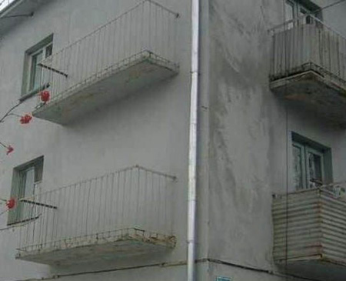
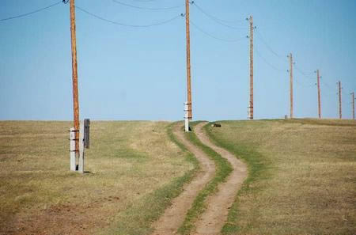
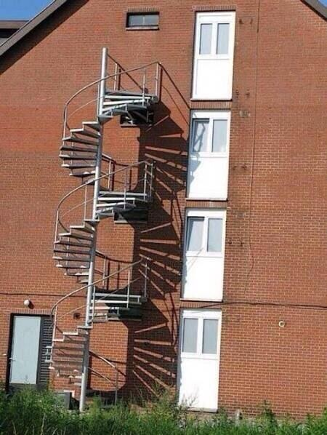
I started learning again.
Did I make mistakes?
Sure. But,
I was on the path.
Notes:
SLIDE PURPOSE: This is where everything starts – us defining with our customers how we can make an impact in their business regardless of the technology!
SPIEL: Technology should be transformative, not a to-do list. Because, really, just about any firm can change the way your IT works. Our mission is for IT to change the way your business works. The difference is a game-changer.

Slide 8
You are not [going to be] a very good “carpenter”
if your own house isn’t full of your own projects.
The only way to learn is to do.
Don’t expect to learn everything from your school or employer.
Notes:
SLIDE PURPOSE: This is where everything starts – us defining with our customers how we can make an impact in their business regardless of the technology!
SPIEL: Technology should be transformative, not a to-do list. Because, really, just about any firm can change the way your IT works. Our mission is for IT to change the way your business works. The difference is a game-changer.

Slide 9

In the Microsoft data platform field? Join SQL PASS (sqlpass.org). Or, join other tech orgs in your field.
Join your local User Group(s)
Go to stuff like this SQLSaturday: Hey congrats, you’re already here!
All this stuff is really good for your professional networking!
Keep getting more involved!

Slide 10
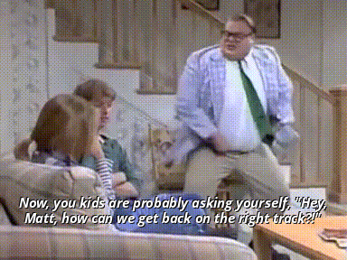
How can you be a better carpenter?
Technical Blogging
Speaking
NOT Volunteering. (Will explain.)

Slide 11
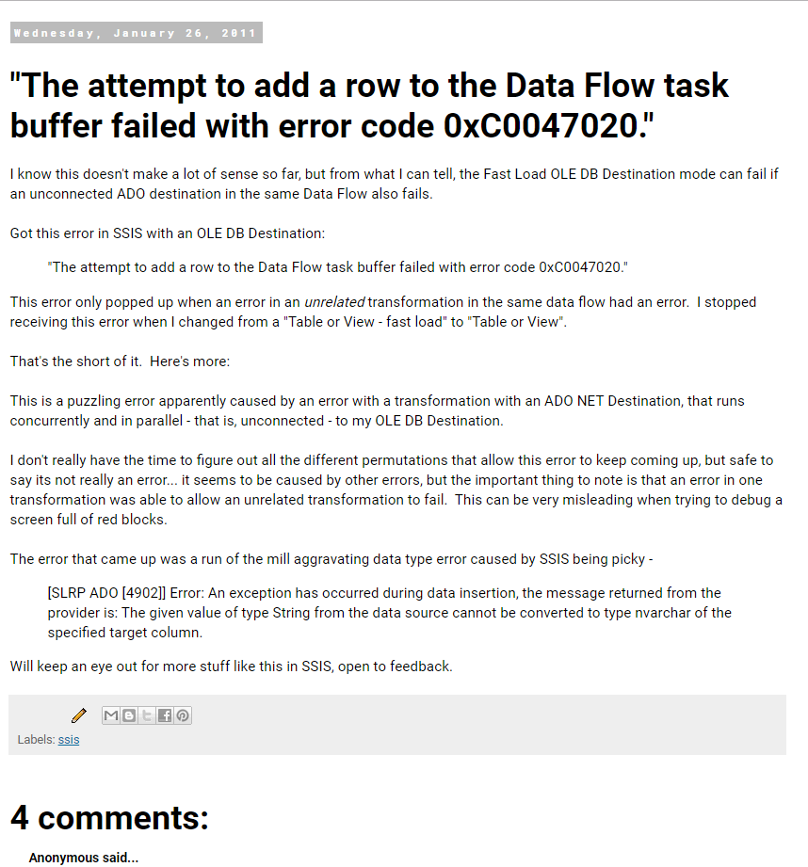
Top 2 Tips for Coming Up With Blog Topics
Consider creating a technical reference blog, as opposed to a timely/news/topical blog.
Lower your expectations of newness, Copernicus. Blog posts do not have to be startling new discoveries.
For example, this 2011 bug report is my all-time most popular blog post:
🤷‍♀️

Slide 12
Top 4 Tips for Coming Up With Blog Topics
Blog posts should be useful, for example, they reference a specific message, problem/workaround, factoid, or feature.
Don’t be afraid to take a similar approach as link bait:
Top 4 Questions to Ask when …
Top 10 Features of …
My Top 72 Favorite Things about…
Top 4 Tips for Coming Up With…

Slide 13
Top 6 Tips for Coming Up With Blog Topics
Your technical blog is not your personal blog.
No politics, no religion, no money talk.
Same for social media! Have a “professional” Twitter presence too.
Draw inspiration from your day to day work.
Answered a question via a long email?
Learned something useful?
Think it’d be helpful to others too?

Slide 14
How to Raise a Technical Talk
Write a summary of what you want to cover, specifically. Don’t be too broad or general.
Write a demo of the thing. Do it quick and simply. Don’t overcomplicate your demo with tangents.
Make the demo robust enough to answer your own questions, anticipate questions like “Why did you…?”
Give the presentation in a User Group Lightning Round (like this!)

Slide 15
How to Raise a Technical Talk
Give the presentation at work, invite peers to “Lunch and Learn”
Grow the presentation in response to questions/comments.
Give the full-length presentation at a User Group.
Give the presentation at SQLSaturday.
….
Profit!

Slide 16
But Public Speaking Is Too Hard
Give Toastmasters a try for a little while. You’ll learn/grow every time, based on participation.
Practice. This sounds obvious, but really, do it.
Record yourself. Cringe. Adjust. Repeat.
Ask more experienced speakers for feedback. Many in this room would be happy to, count me in.
You get to decide your audience. Your talk’s scope/depth will be inconsistent unless you decide.

Slide 17
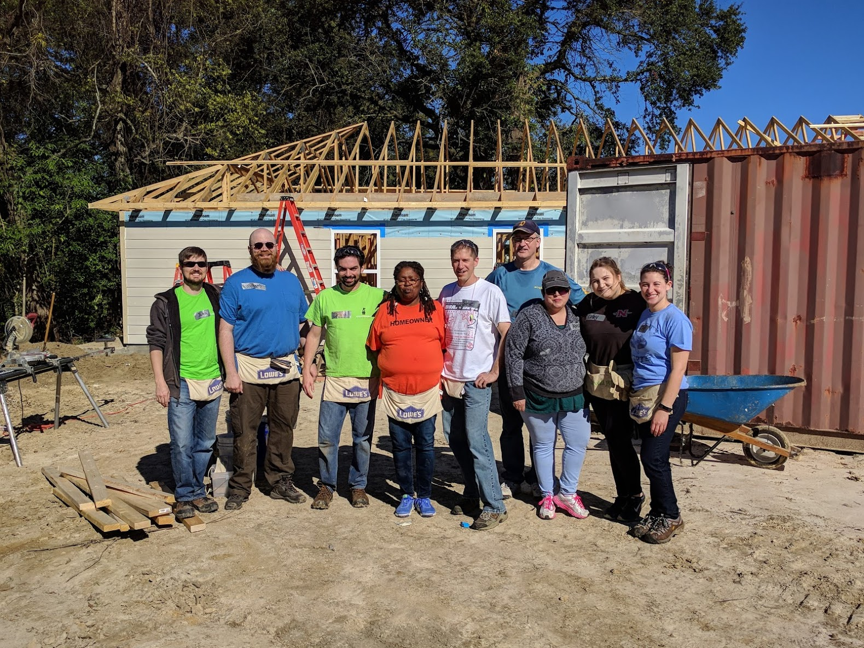
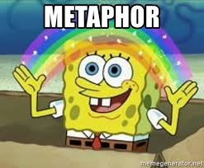
Confession Time
I’ve never actually been a carpenter.

Slide 18
I Wasn’t Really A Carpenter, But I Did Learn
Get organized. Keep getting more organized.
Take notes in OneNote, not paper. You can’t Ctrl+F paper.
Get a task list, check it.
Email hygiene is real. Clean that inbox.
Keep a calendar, if you have a partner, share your calendars. Seriously.
Personal organization ideas must be YOURS.

Slide 19
I Wasn’t Really A Carpenter, But I Did Learn
Stop fearing being wrong, start fearing becoming obsolete. Stay technical!
Learn to admit when you’re wrong, and stop wasting time covering it up.

Slide 20
I Wasn’t Really A Carpenter, But I Did Learn
4. Have a can-do attitude.
Don’t be a fault-finder.
Don’t think of roadblocks as a default method of contributing to discussion.
Start treating your colleagues like friends, not like assets or competition or frenemies.

Slide 21
I Wasn’t Really A Carpenter, But I Did Learn
Never pass up an opportunity to give a sincere "Great job!“, even to a peer.
Never ever ask a woman if she is pregnant.
Never ever ask a woman if she’s a “booth babe”.
Don’t hate.
Caffeinate Activate!

Slide 22
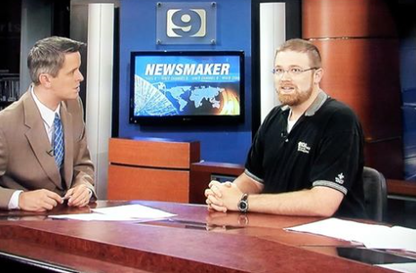
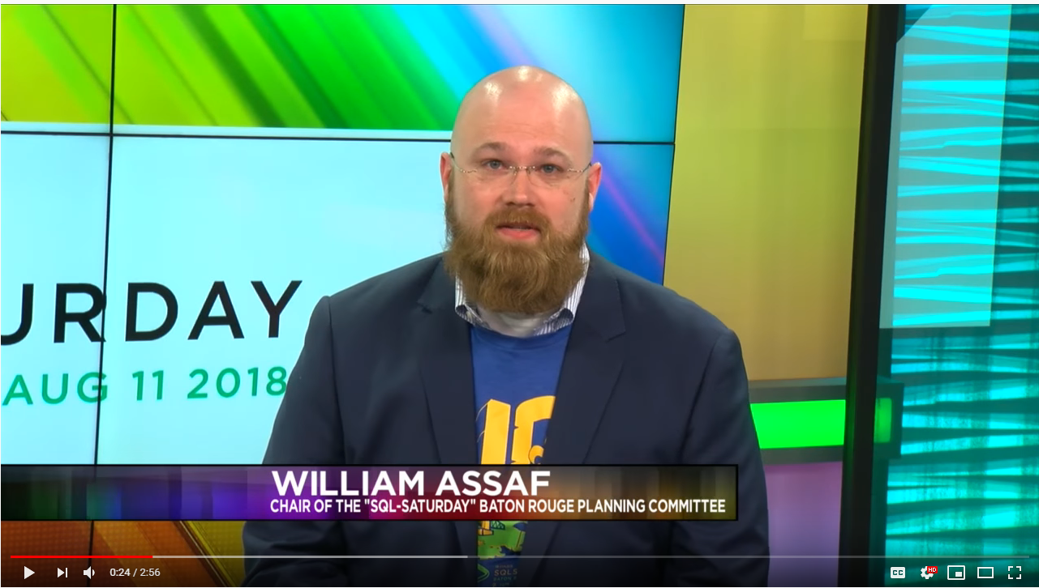
In conclusion, get involved in your local tech community.
BUT DO NOT volunteer for SQLSaturdays, it’s definitely not fun, it’s definitely not good for your career, or your hair, just look what it does to you!
(just kidding)

Slide 23
Grand Finale
New habits are like going bald.
Knew I needed to
Finally decided to
Was a shock initially, not just to me but everyone
Not everyone liked it, but they got over it
5 years later, can‘t believe I ever liked having hair
I encourage you to follow up on your desired habits.
“Those who do the things, do the things.” –my wife

Slide 24

SQL Server 2017 Inside Out
SQL Server 2017 Administration Inside Out
Published Feb 2018 by Microsoft Press
2nd edition for SQL 2019 coming Nov 2019*
*just a guess

Slide 25
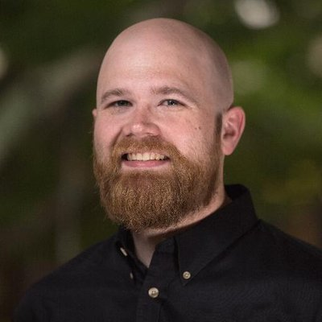
Bio and contact
William D Assaf, MCSE
Baton Rouge SQL Server UG board
Principal Consultant, SQL Manager at Sparkhound
William.Assaf@sparkhound.com
Twitter: @william_a_dba
This presentation available at my blog:
SQLTact.com

